Slide 1
https://groups.csail.mit.edu/tds/papers/Merritt/podc84.pdf

Slide 2
Mitchell and Merritt’s Algorithm for single resource model
Works on the single resource model Belongs to the class of edge-chasing algorithms where probes are sent in opposite direction of the edges of WFG.
Each node has two labels- Private and Public where initially both has same values
Private is unique but might change
Has four nondeteministic state transitions
- Block, Transmit, Detect, Activate

Slide 3
Automatic detection of cycle – no one has to keep checking for it

Slide 4
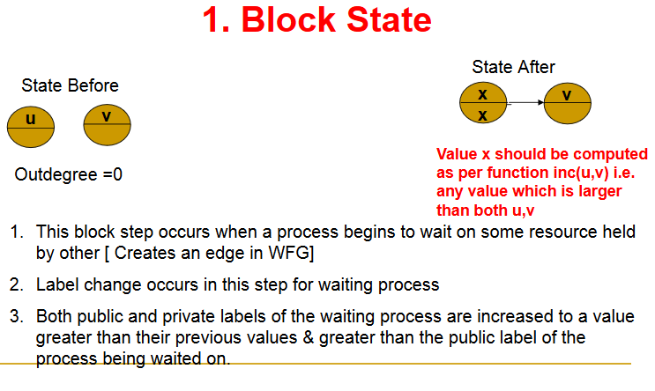
The value incremented to has to be unique to that node.

Slide 5
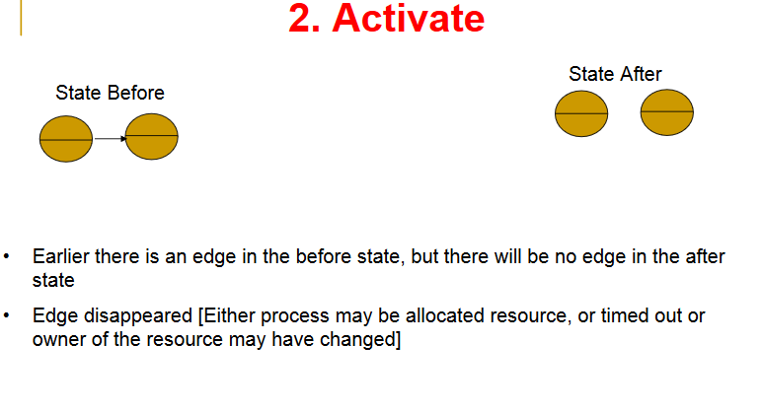

Slide 6
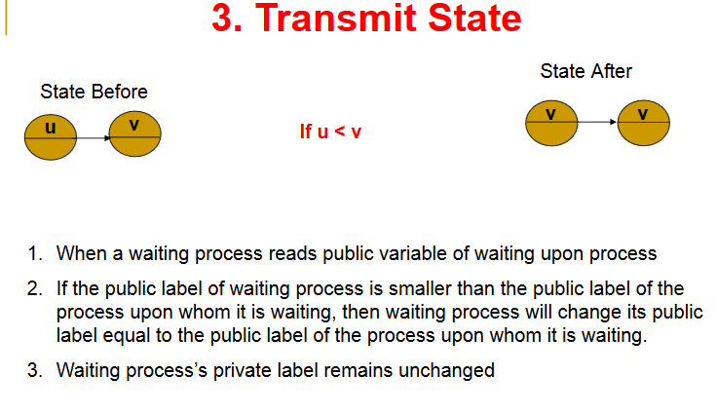

Slide 7
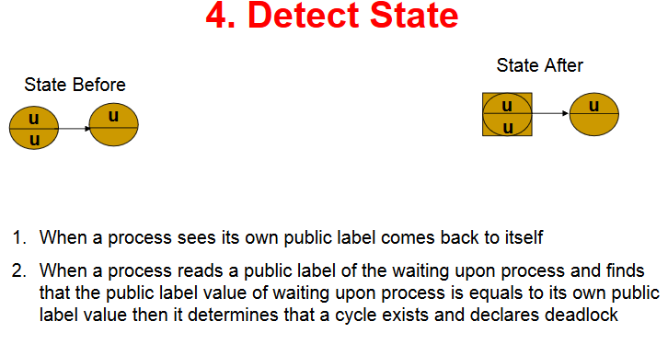

Slide 8
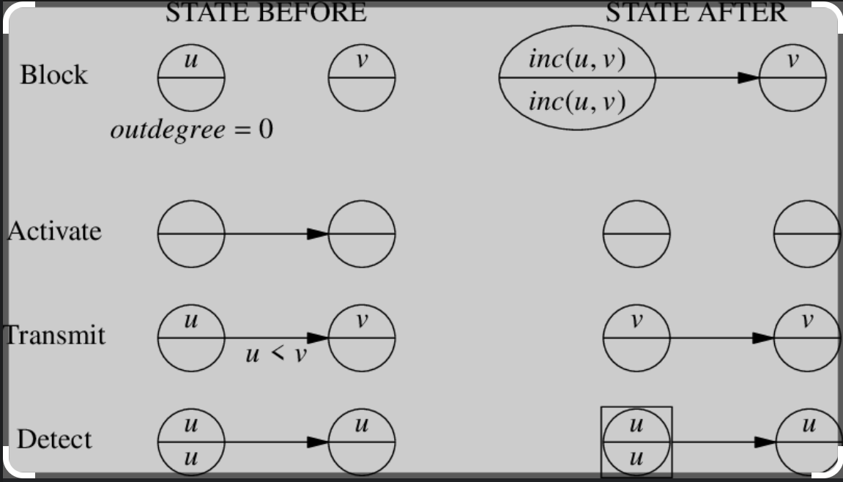

Slide 9
Questions
Can a node be part of multiple cycles?
Suppose a node has added the last edge of a cycle and hence started a transmit. Can his private and public label change by the time the transmit reaches him back?
Does the start of a transmit imply the presence of a cycle?

Slide 10
Can another node also have your public value though not in a cycle?
In case of a cycle, the process that detects the deadlock with have the highest public id in the cycle. T/F?
Can a process ignore a transmit probe if the value is lesser than its own.

Slide 11
H.W Can there be phantom deadlocks?
H.W Is the last process to block same as the one who detects the deadlock?

Slide 12
Only one process in a cycle detects the deadlock. This simplifies the deadlock resolution – this process can abort itself to resolve the deadlock. This algorithm can be improvised by including priorities instead of process id’s and the lowest priority process (highest id) in a cycle detects deadlock and aborts.

Slide 13
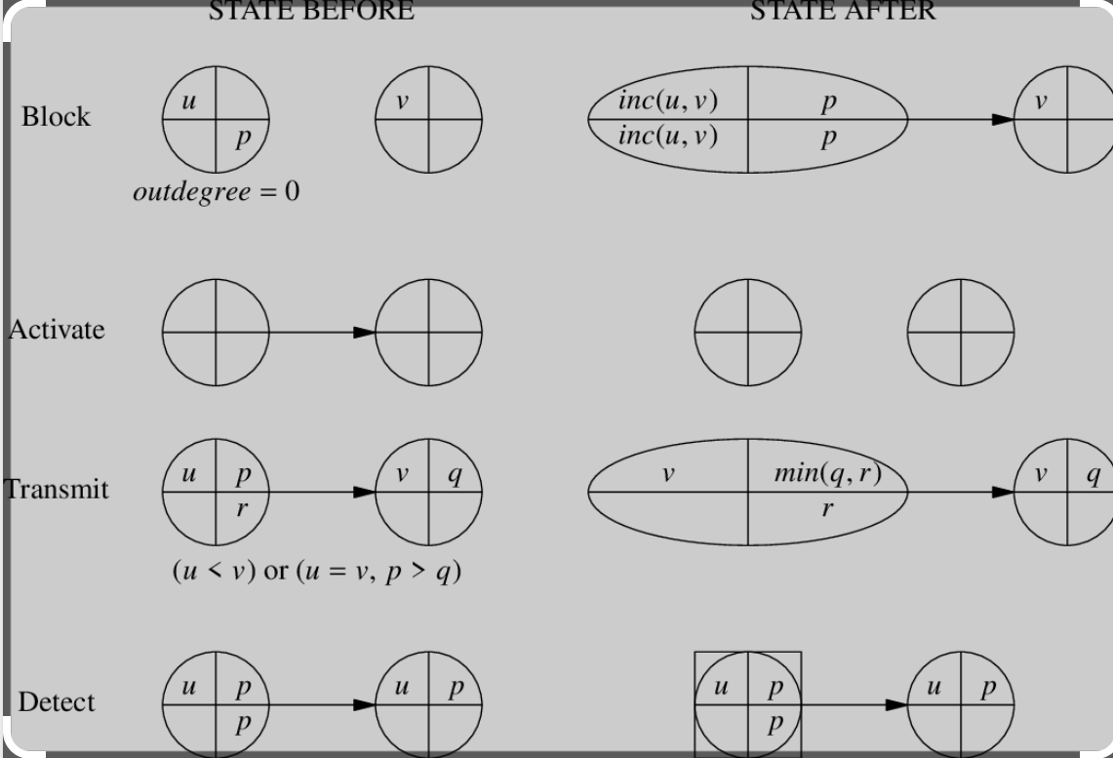
With Priority. Higher Number indicates Higher Priority

Slide 14
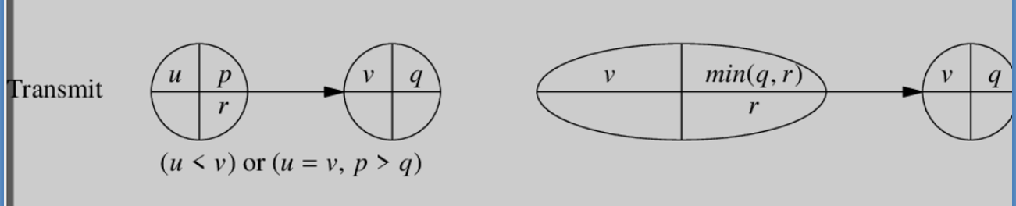
Transmit with Priority
If u>v : no transmission
If u<v: should transmit . Let the new public tuple of the blocked node be (a,b). Then, a=v because transmission should happen. b should be the lowest in the transmitted chain so that on transmission in a cycle; the lowest priority finds his own public label and priority number and aborts.
If u==v; then, if p>q that means transmission should continue so that lower priority process aborts. Consider example in the pdf

